Slide 1
ePortfolios
Gary Coyne, Undergraduate Education
Lourdes Maldonado, University Honors
Sheryl Hathaway, Instructional Design

Slide 2
Introductions and Outcomes
Introductions: Who are you and what do you want to get out of the next hour?
Outcomes: What we hope you will get out of the next hour
Participants will have a general familiarity with ePortfolios
Participants will be able to identify examples of ePortfolio platforms
Participants will understand some basic considerations in adopting and rolling out an ePortfolio initiative

Slide 3
ePortfolios
An ePortfolio is a collection of digital artifacts or archive on the web that:
Can serve as an archive
Can serve as showcase or final product
Can be an assignment in one courses
Can be worked on over several courses or quarters/years
Can prompt students to be reflective and integrative
Can serve as an effective site to assess student learning

Slide 4
Examples of ePortfolios
Art: https://dakotasumpter.com/
Writing: https://bu.digication.com/connielu/Home
Science: https://stonybrook.digication.com/biodesign_group_5/need

Slide 5
The ePortfolio Journey
Lourdes Maldonado, M.S. Educational Counseling
University Honors

Slide 6
“We’re out to find the wizard…”
Honors counselors observed students having extreme difficulty with personal statements (graduate school, internships, and scholarships). Honors counselors believed if students had some kind of portfolio, it could aid students when reflecting on their undergraduate experience.
An Honors portfolio could also allow students to showcase their work and achievements and assist them in marketing their skills and abilities to future employers.
An Honors portfolio could also help to further brand the University Honors program and aid in recruiting high achieving students.
Notes:
The portfolio selection process began in the spring 2015 term. In order to best search and find an eportfolio for UH, it was necessary to identify the purpose for the portfolio, what was it for? And who was it for? We identified one clear need but then found other ways a portfolio could be beneficial, such as a tool for recruitment, to engage alumni, and fund development. “Hey, a portfolio can help students but it could also help the department!”

Slide 7
Honors ePortfolio Desires/Wants
We wanted the ePortfolio to be a repository of milestones and accomplishments which would aid students in their reflection of their undergraduate experience, specifically Honors. We wanted the ePortfolio to include:
Publications and research
Co- or extra-curricular activities
Leadership activities
Study abroad experiences
Career documents, for ex: resume
Notes:
We wanted the eportfolios to be a repository of achievements and a tool that students could use for reflection.

Slide 8
We also wanted the portfolio to be…
Portable
Simple to use
Accessible to both students and Honors staff
Currently used or approved by other national Honors programs/colleges or, ideally, another UC program
Compatible with current software and applications (i.e dropbox, google drive)
Provide a section for advising notes available to staff
Best product on the market*
Notes:
We wanted the eportfolio to be portable so that students could take it with them once they graduated.
We wanted a simple to use platform, why? So that students could easily adopt, therefore increasing student buy in, but also for faculty/staff, we didn’t want to have to learn yet another program.
We wanted Honors staff to have access so that we could use eportfolios for outreach purposes, alumni and fund development, and we thought, “hey, we can use for future accreditation needs”.
We wanted a tool that was vetted and trusted by other campuses. Did not want to fall in a trap of going with a startup that had no lasting power.
Because we are aware of the multiple methods students use to store their coursework or records, thought it would be great if eportfolio tool could work easily with these applications.
It was a great idea not to put a budget restriction from the outset. It helped me brainstorm and discover what was out there

Slide 9
The Flood Gates Opened
Called UCR IT and UE IT to obtain recommendations
Obtained recommendations from colleagues
Conducted google search on a daily basis using varying key terms (portfolio, assessment of learning outcomes,etc)
Found and read articles and blogs regarding eportfolio use and benefits
Compiled information on spreadsheet to better compare and contrast programs
Stop. Assess progress. Determine next steps
Needed a more strategic way of searching for ePortfolios
Consulted UCR IT Director, Leo Schouest, who provided a clearer understanding on “types” of eportfolios
Notes:
In all, this yielded somewhere around 20-25 products

Slide 10
Different Strokes for Different Folks
3 main categories
Showcase. A collection of exemplary work. Can be used at final stage of a program of study to show a student’s level of skills. Student creates content and uploads information to be shared.
Learning/Instructional. A collection of evidence that demonstrates intended learning outcomes for course/program. Allows for faculty to be more selective about content and what counts.
Administrative. A collection of student’s completed tasks and requirements for a program/major. Provides counselors and other administrative staff control over content.
Notes:
Many different types of portfolios out there for different needs, functions, and budgets. We wanted an eportfolio that could do it all. Although, I searched for the ideal portfolio, I found portfolios to be slanted towards one of the three types.

Slide 11
Selection of Eportfolio
Demonstrations
Digication
Chalk n’ Wire
Simplicity
Digication Fall 2015
Consultation of pilot to UCR IT, UE IT, and Institutional Research
16 students
8 weeks
Formative and summative assessments
Notes:
Chose a vendor for each type of portfolio and invited vendors to demonstrate products; Digication (showcase), Chalk n Wire (learning, instructional), Simplicity.
Consulted UCR IT, UE IT, and Institutional Research on pilot selection
Based on previous program and budget management experience, strongly advocated for a pilot in lieu of full experimentation.

Slide 12
Back To The Drawing Board
Conducted more field research
Nathaniel Wildes, UCR IT
Honors Learning Community
Dr. Helen Chen, Stanford
Seamless integration with LMS
Sufficient “back-end” support
Cost
National Collegiate Honors Council Conference. Chicago, IL
Notes:
We revisited needs, wants, and desires. Asked “what do we (as an office) really need”, “what do we, and should we, invest our resources in (time, money, staff)”. Looked over self study report 2020 strategic plan and assessment came forward as an indisputable need. Also further reflected on Director’s comments and feedback and identified assessment as a key aspect for portfolio adoption
As a group, decided that the product needed to be user friendly and faculty friendly. We also realized we wanted our eportfolios to allow us to conduct assessment of student learning but provide us with analytics (how many students submit capstone proposal on time). Digication did not allow for these items.
I consulted IT again to discuss eportfolio options and to follow up on information obtained by Leo Schouest at our first meeting, regardin campus purchasing eportfolio option through Bb. Because that option was not currently available. Nathaniel Wildes proposed the idea of creating an Honors course (learning community within blackboard).
Attended a workshop at NCHC and observed this campus using their current LMS
Came across sample portfolios through Stanford school of education. Contacted Dr. Helen Chen to talk more about the portfolio process and selection their school used. Discovered she was a consultant for the AAC&U regarding use and benefits of eportfolios. She helped clarify my search and provide me with additional selection criteria when choosing eportfolios

Slide 13
“Integrating Honors Requirement Tracking into the University IT Infrastructure: A Tale of Three Systems”-New Jersey’s Science & Technology University
Notes:
Took an interest because our campus moving to banner and also continuously work with registrar office to submit names to students that will have honors completion on transcript.
Using my new guidelines of integration, tech support, and cost and seeing a real life example. I decided to further pursue Blackboard as an option. Using the information gathered, I set-up a meeting with Director, Richard Cardullo, and presented idea of Honors course using documented evidence and information. At the end of Winter 2016, began Bb Honors course pilot.

Slide 14
BlackBoard Honors Course
Pilot Winter 2016
16 Students
HNPG courses
Next steps
Surveys
Capstones
Managing email communication to students
eportfolio on BlackBoard

Slide 15
ePortfolio Tools
Sheryl Narahara Hathaway, PhD
Academic Engagement

Slide 16
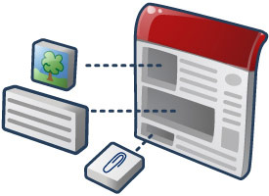
Google Apps
Google Drive (http://youtube.com/v/jWvKAYKlnnM)
Google Sites (http://youtube.com/v/tkTGrOcFiz0)

Slide 17
Omeka (http://youtube.com/v/wHu7SwiviPw)

Slide 18
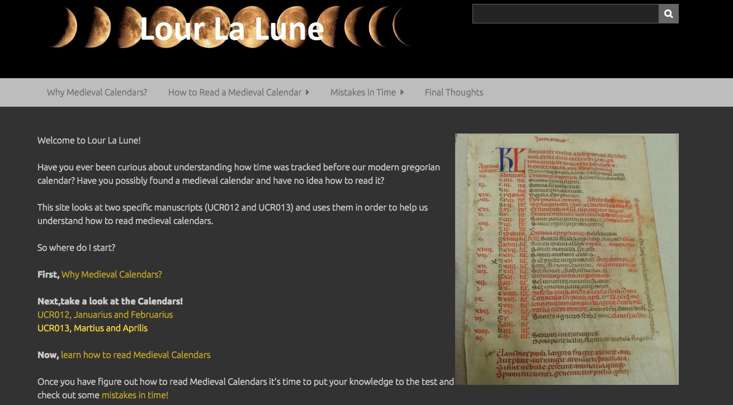
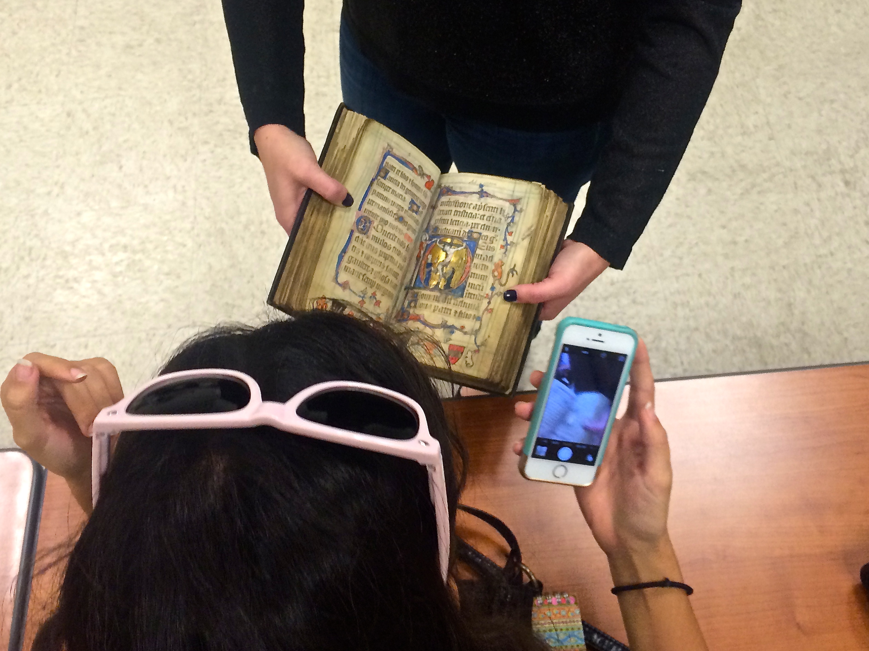
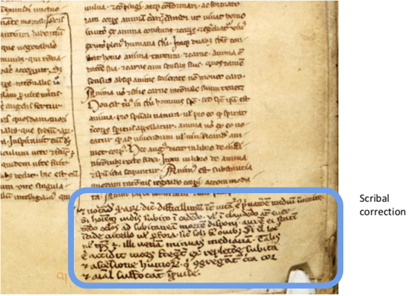
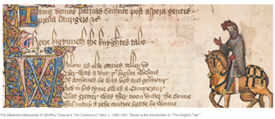
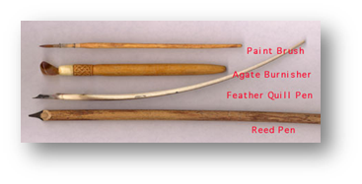
Digitally Enhanced: Andrea Denny-Brown [English]
Traditional
Completely Online
Notes:
Professor Denny-Brown teaches courses on Medieval Literature and is partnering with the Huntington Library on a Digital Manuscripts project.
In her classes, she “introduces students to English medieval manuscripts in the digital age.”
For the midterm project, Professor Denny-Brown assigns group work to students who enact the roles of scribes, illuminators, and paper makers “to produce a manuscript quire of 8 pages, using medieval techniques of book-­‐making.”
She also incorporates the web-based curation tool called Omeka, allowing students to gain practice at being content developers by creating digital collections of their own.

Slide 19
Others
Portfolium (http://youtube.com/v/7ZteDvG9a3I)
Chalk & Wire (http://youtube.com/v/3wYwo4_EHYg)

Slide 20
Assessing ePortfolios
Begin with the end in mind
What should students gain? (learning outcomes)
How will you know if they did learned it? (assessment methods)
Assessing the ePortfolios
How many students completed them? (system generated data)
What did they think of the process? (surveys)
ePortfolios for assessment
To what extent are students meeting expectations? (rubrics)
Students do most of the work assembling evidence of their learning
and then the internet brings it all to you

Slide 21
Additional Resources
Reading:
1. Clark, J. E., & Eynon, B. (2011). “Measuring student progress in E-portfolios.” Peer Review, 13/14.
2. Clark, J. E. & Eynon, B. (2009). “E-portfolio @ 2.0: Surveying the field.” Peer Review, 11.
3. Light, T. P., Chen, H. L., & Ittleson, J. C. (2012), Documenting learning with Eportfolios, Chapters 1–9.
4. Yancey, K. B., (2009). Reflection and electronic portfolios: Inventing the self and re-inventing the university. In D. Cambridge, B. Cambridge, & Yancey, K. B. Electronic Portfolios 2.0. Sterling, VA: Stylus.
Examples of ePortfolios
http://www.digication.com (Several good examples near the bottom of the landing page for this ePortfolio tool provider.)
Examples of Work Assessing ePortfolio
http://ncepr.org/cohort5.html (Several good examples of assessment of eportfolio projects, including some details of how the projects were developed and rolled out.)

